Slide 1
Compression

Slide 2
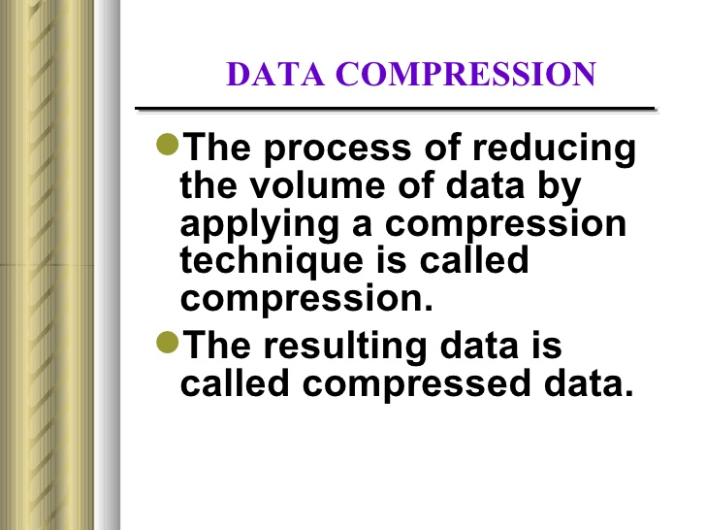

Slide 3
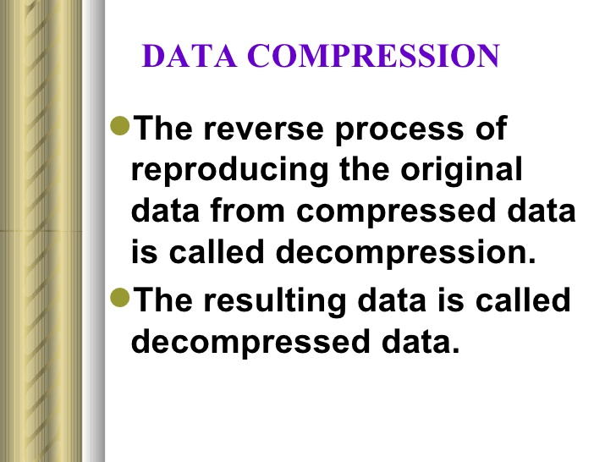

Slide 4
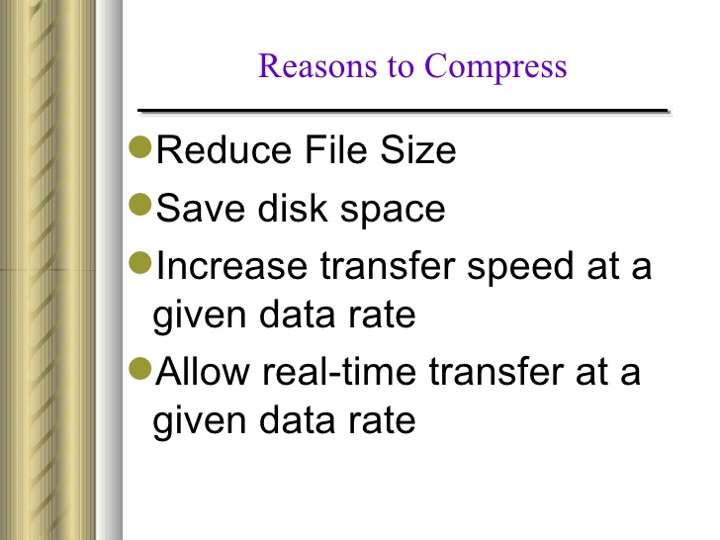

Slide 5
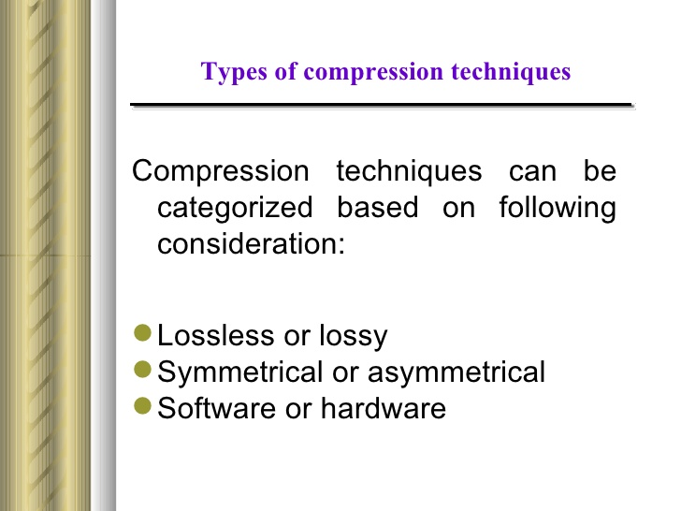

Slide 6
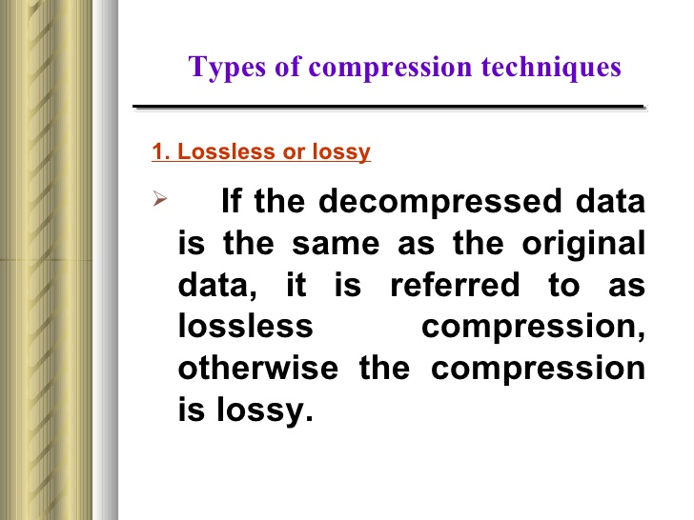

Slide 7
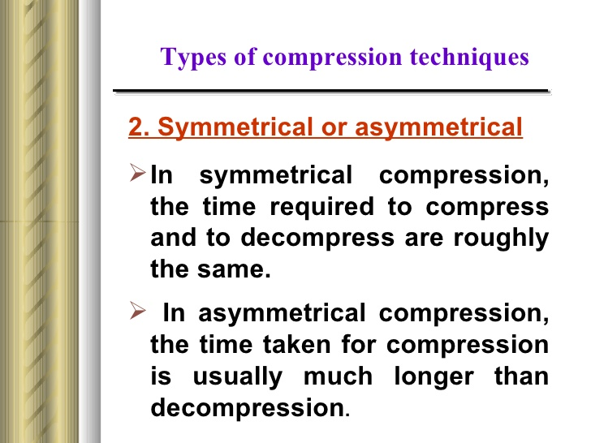

Slide 8
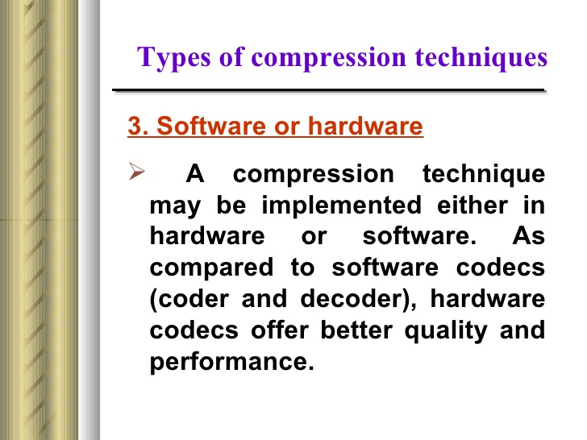

Slide 9
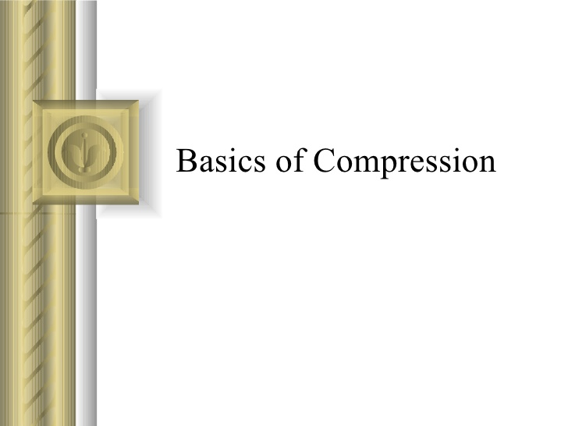

Slide 10
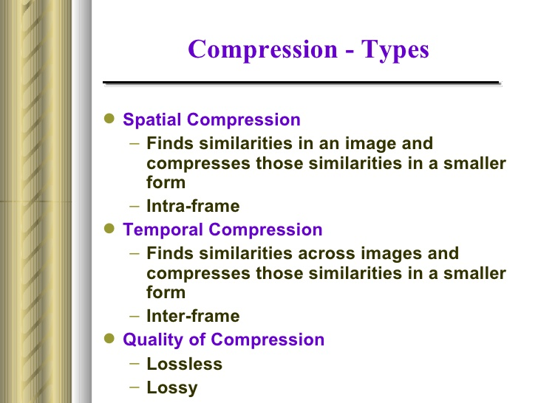

Slide 11
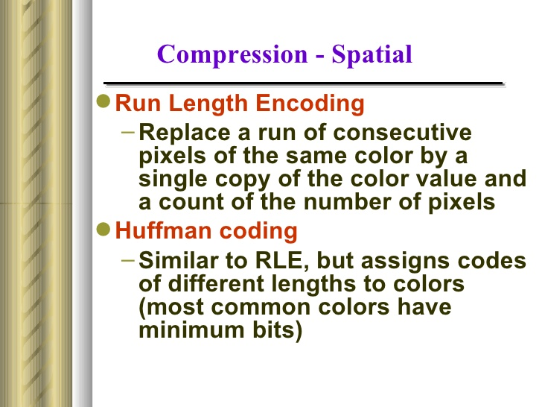

Slide 12
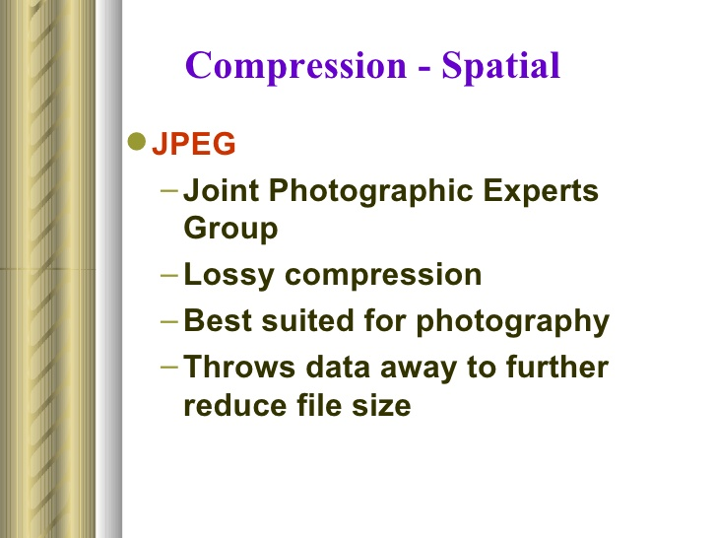
First international standard in image compression

Slide 13
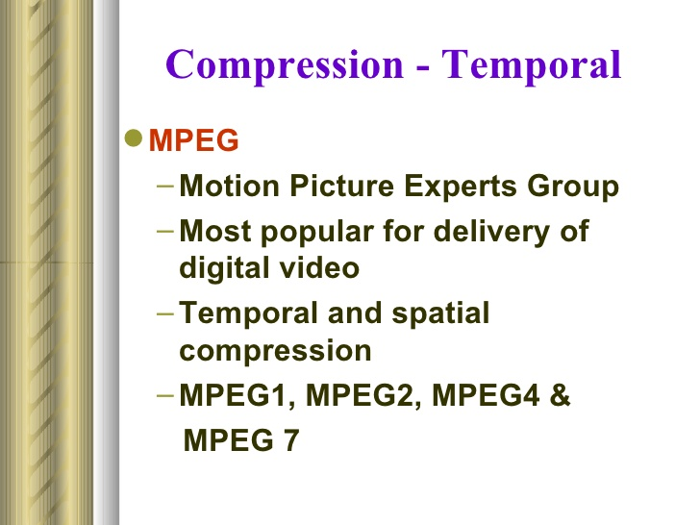

Slide 14
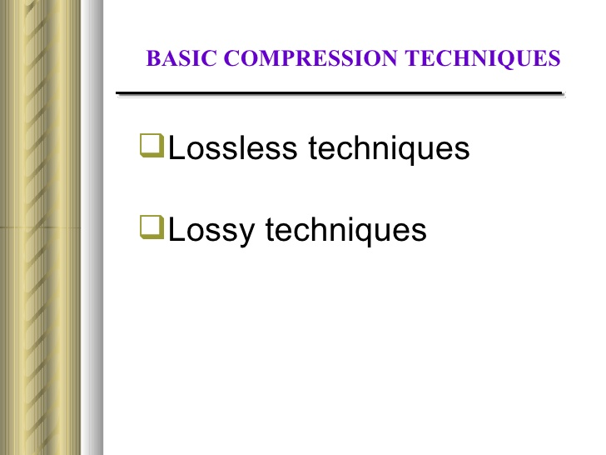

Slide 15
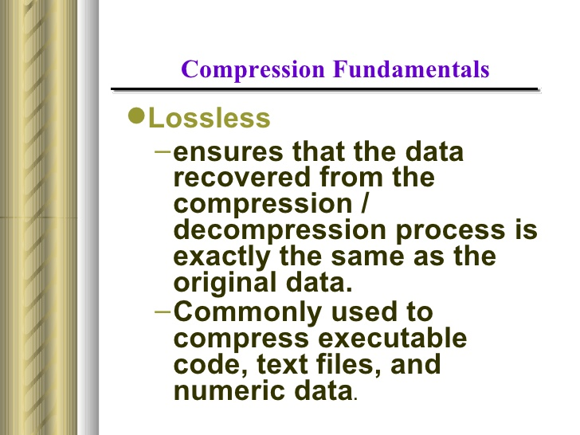

Slide 16
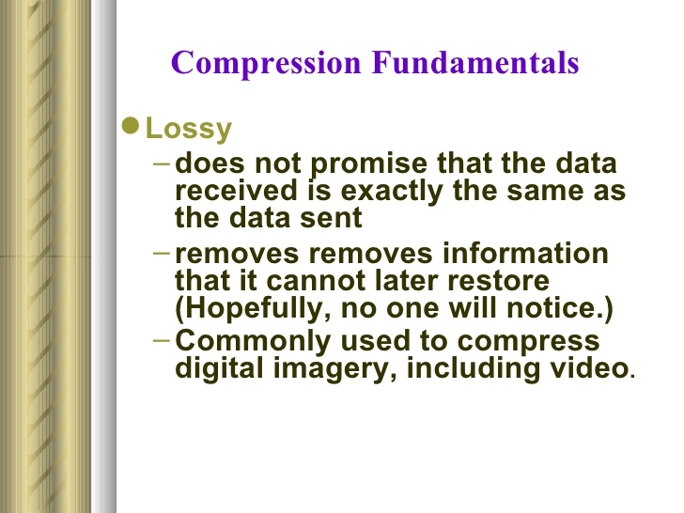

Slide 17
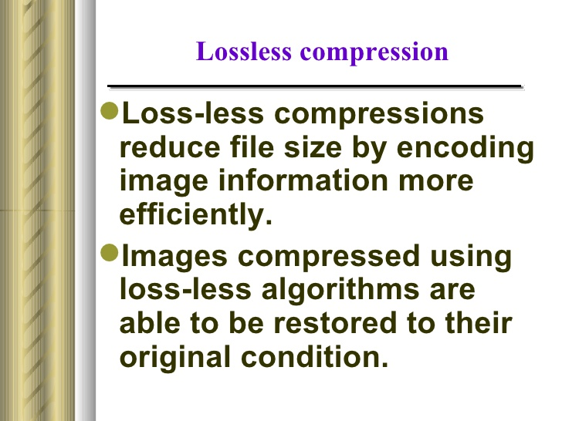

Slide 18
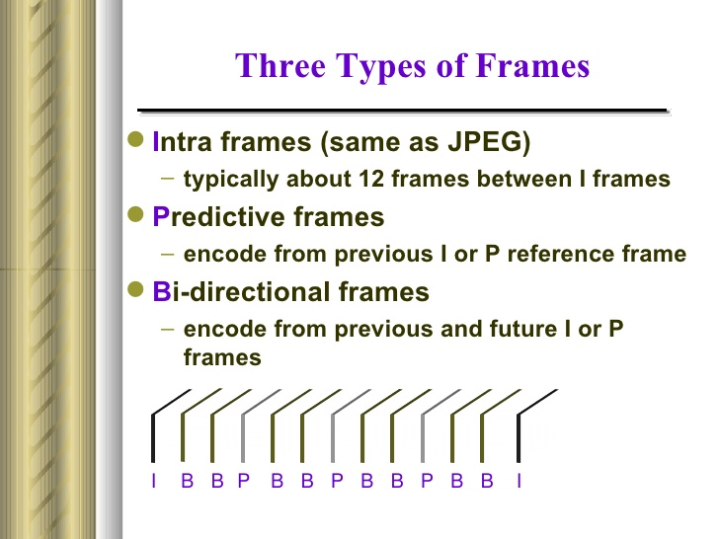

Slide 19
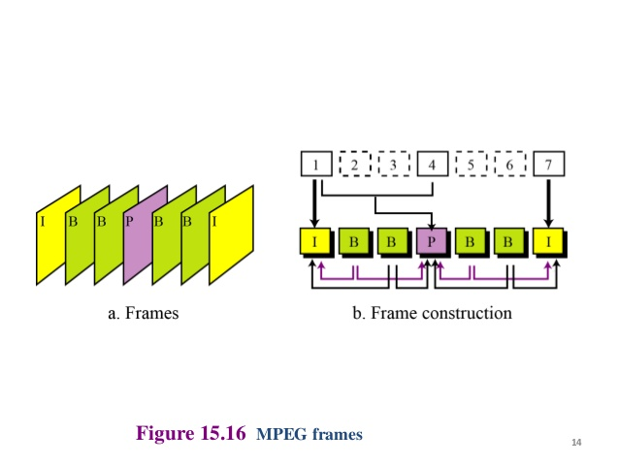

Slide 20
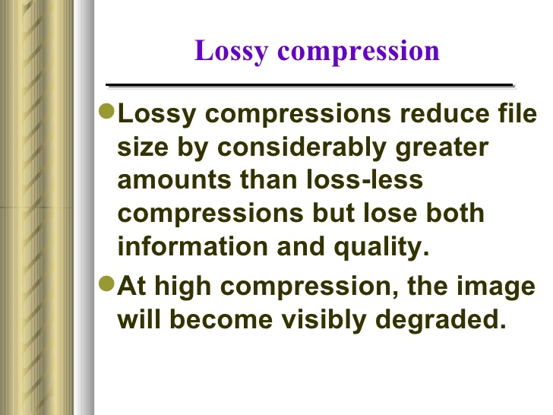

Slide 21
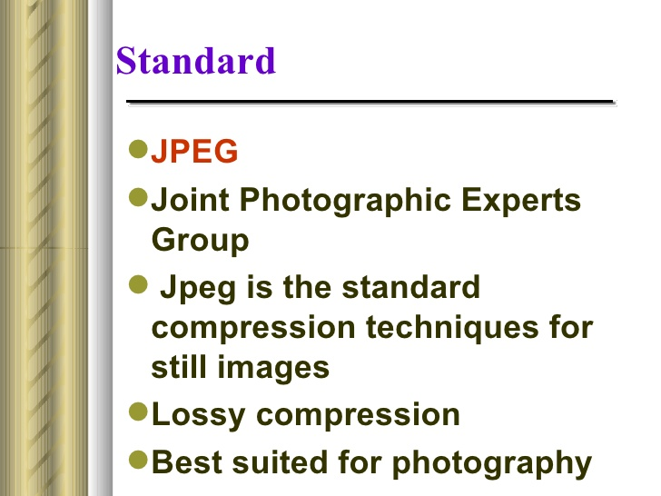

Slide 22
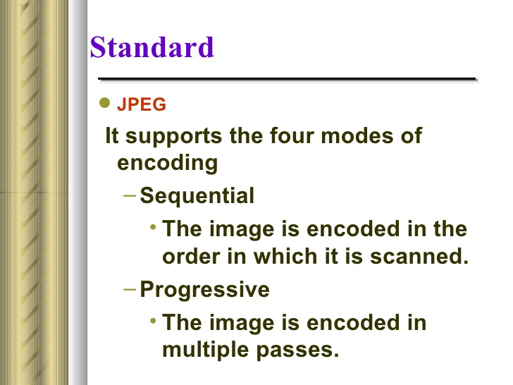

Slide 23
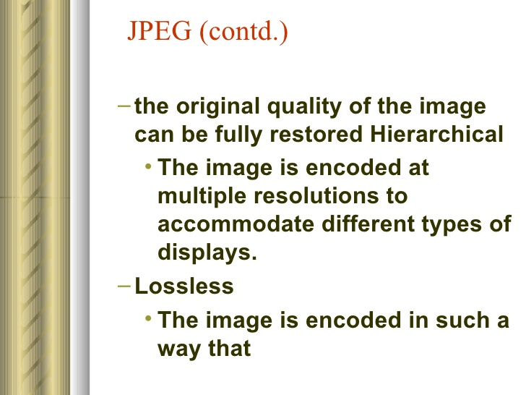

Slide 24
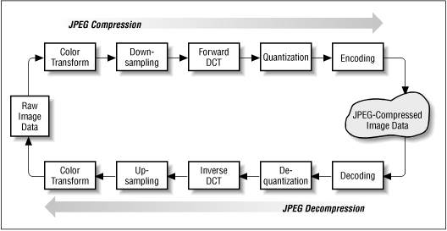
JPEG Compression & Decompression

Slide 25
Steps of JPEG Compression
The JPEG standard specifies a multi-level coding process: 1. Image Preparation (Separation into Components) The image will be separated into components, which are adapted to the different quality requirements. 2. Transformation (DCT: Discrete Cosine Transform) Each individual component is transferred into a format, that allows to make conclusions about the structure of the contents. This offers the option to distinguish between basic and more complex contents. 3. Quantization (Weighting of the Contents) The transformed data are weighted according to their meaning for the image contents. 4. Entropy Coding (Huffman Coding) Elimination of redundant information.

